Slide 1
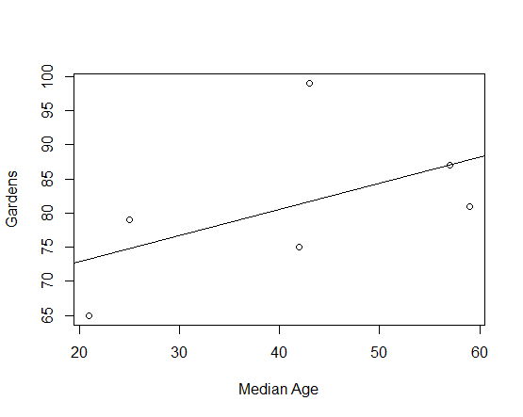
Week 11:Univariate regression
Geog4300: Shannon

Slide 2
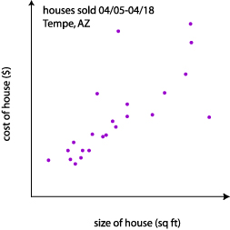
Correlation
tells us how strongly x and y are related
Regression
tells us how a change in x is associated with a change in y
Correlation:
There is a strong positive relationship (r=0.81) between the size of a house and its selling price.
Regression:
The price of a house goes up $10,000 for each additional 500 square feet.
Notes:
Alternative hypothesis is usually what you’re trying to prove.

Slide 3
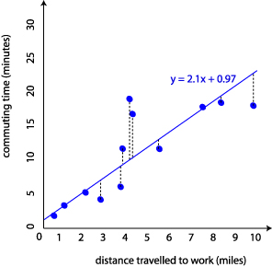

Some terminology
Regression coefficient (or beta)
Error term
R²
Residual
$$y=βx+ ε$$
R² = 0.65
Notes:
Alternative hypothesis is usually what you’re trying to prove.

Slide 4
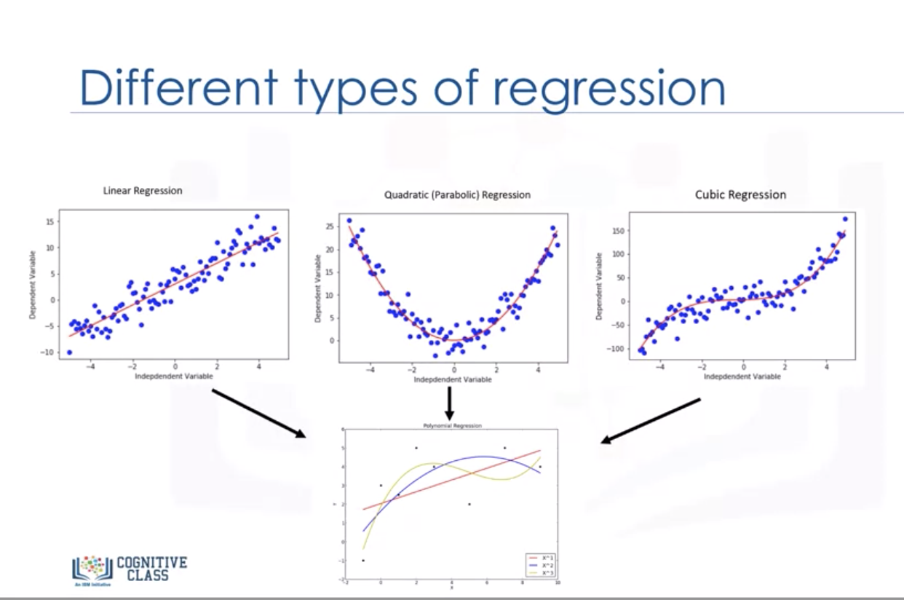
Not all regression uses a linear form
Notes:
Alternative hypothesis is usually what you’re trying to prove.

Slide 5
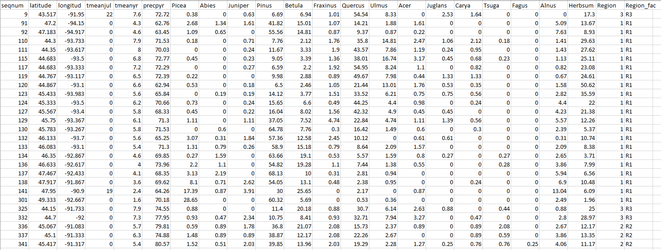
Regression in Excel
Choose Regression in the Data Analysis add-in
Select just the cells with your data, including labels.
Notes:
Alternative hypothesis is usually what you’re trying to prove.

Slide 6
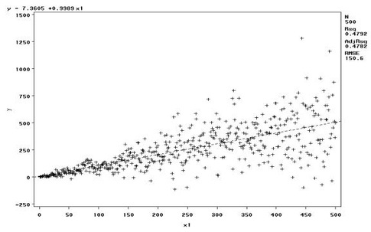
Diagnostics
Are your residuals normal?
Heteroskedasticity?
What about outliers?
Notes:
Alternative hypothesis is usually what you’re trying to prove.

Slide 7
Calculating residuals and testing normality in Excel
Use the formula that regression gave you to calculate expected values.
What’s the difference between observed and expected?
Chart those using a histogram and/or boxplot in Excel
Notes:
Alternative hypothesis is usually what you’re trying to prove.

Slide 8
You try it!
Create a regression model using temperature or precipitation as the independent variable and pollen counts for one tree species as the dependent variable.
Write a summary of the results, focusing on the coefficients’ strength, magnitude, and significance as well as the overall model fit using the R².
Notes:
Alternative hypothesis is usually what you’re trying to prove.

Slide 9
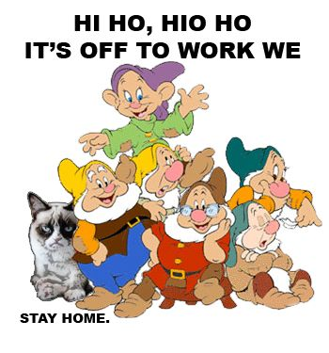
Work time: Lab 4 or 5
Notes:
Alternative hypothesis is usually what you’re trying to prove.

